Slide 1
Creating a React Web App
Creating a simple app
Creating many elements
Data-driven UIs

Slide 2
1. Creating a Simple App
Scenario
Defining a target element
Including React libraries
The virtual DOM
Creating React elements
Rendering React elements
Viewing the React virtual DOM
Logging a React element

Slide 3
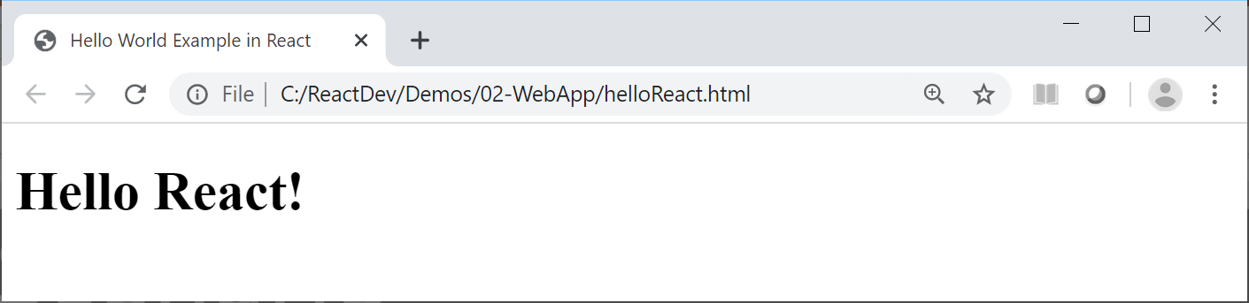
Scenario
In this chapter we show how to create simple React apps in pure React, using ES6++ language features
See the Demos/02-WebApp folder
The first example we'll look at is helloReact.html
This is a minimalistic "Hello World" React app ☺

Slide 4
Defining an HTML Target Element
A React web app has a single top-level HTML element into which React will render the UI
You typically define it like this
Give it a suitable id
You'll refer to this id when you render content (see later)
<div id="osl-container"></div>

Slide 5
Including React Libraries
To use React in a web page, you need 2 libraries:
React - Creates views
ReactDOM - Renders views in the web browser
The following code downloads these libraries directly
Later, we'll see how to use npm to manage these libraries
<script src="https://unpkg.com/react@16/umd/react.development.js"></script>
<script src="https://unpkg.com/react-dom@16/umd/react-dom.development.js"></script>

Slide 6
The Virtual DOM
In a web app, you can manipulate elements using DOM
Create elements, append child element, etc.
DOM is a very low-level API
It takes a lot of code to achieve simple tasks
It can also be really slow at run time!
React introduces the concept of the virtual DOM
You create React elements (lightweight JS objects)
You manipulate the lightweight JS objects, and React renders the appropriate HTML as efficiently as possible

Slide 7
Creating React Elements
You can create a React element programmatically by calling React.createElement()
1st argument specifies the type of element to create
2nd argument specifies the element's properties
3rd argument specifies the element's children
<script>
const msg = React.createElement(
'h1',
{id: 'msg-0', 'title': 'My message'},
'Hello React!')
</script>

Slide 8
Rendering React Elements
Render your top-level React element into a target node on the web page, using ReactDOM.render()
1st argument is your top-level React element
2nd argument is the target node on the web page
<script>
…
ReactDOM.render(
msg,
document.getElementById('osl-container'))
</script>

Slide 9
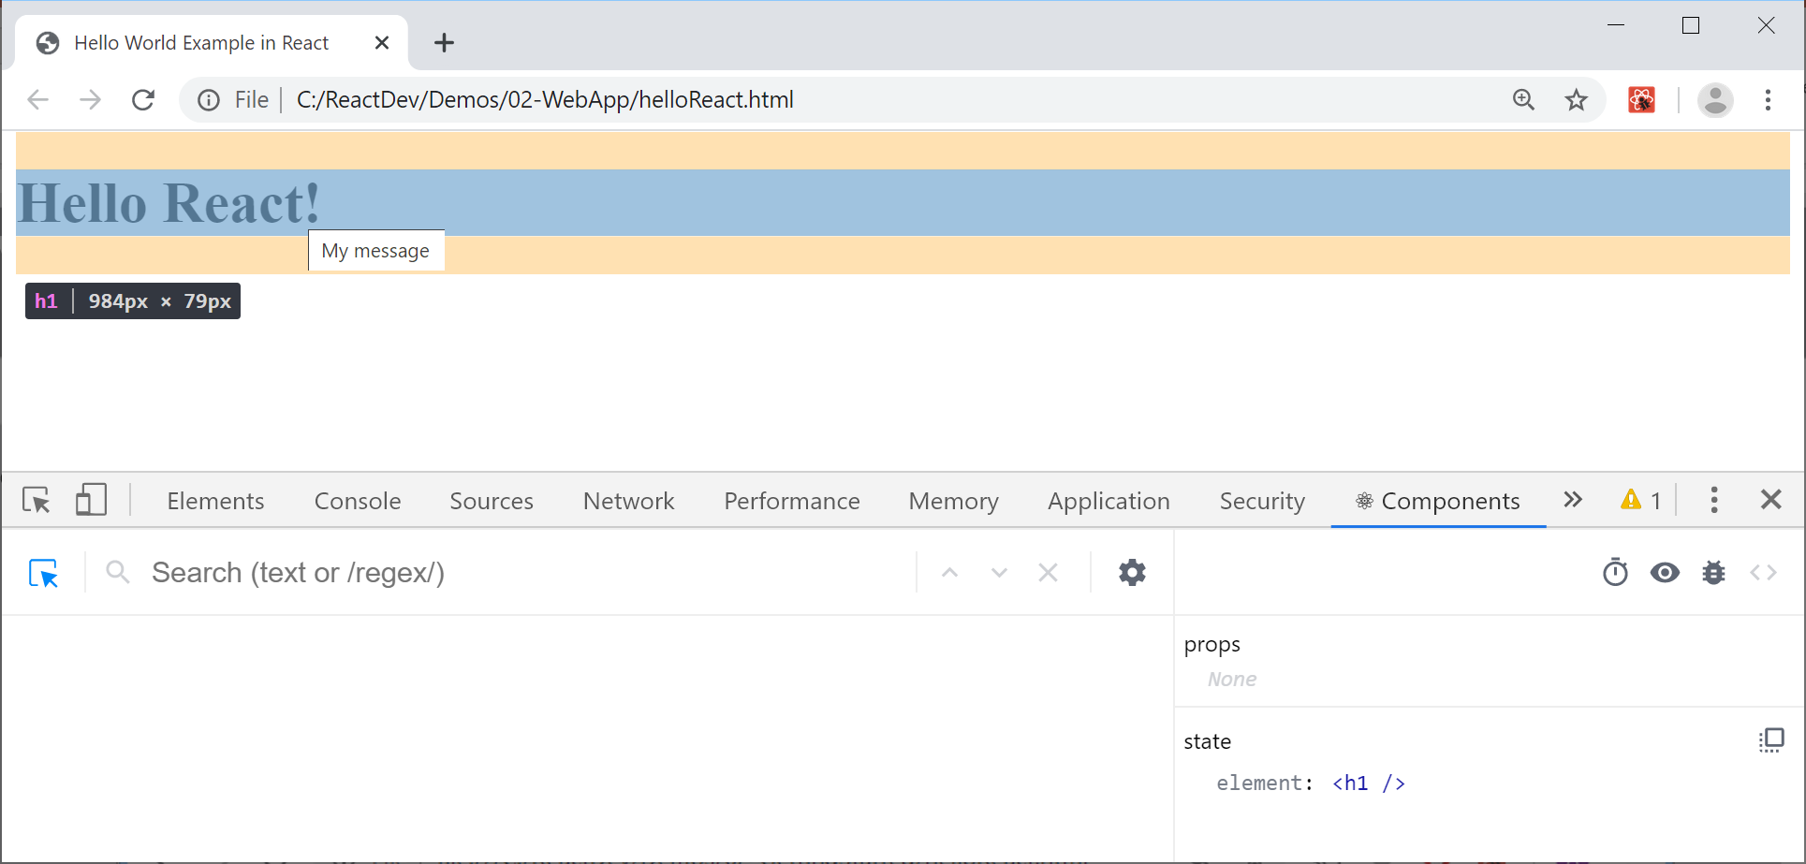
Viewing the React Virtual DOM
Chrome (and other browsers) allow you to view the React elements in the virtual DOM
Install the React Developer Tools extension
Then in DevTools, click Components and select element

Slide 10
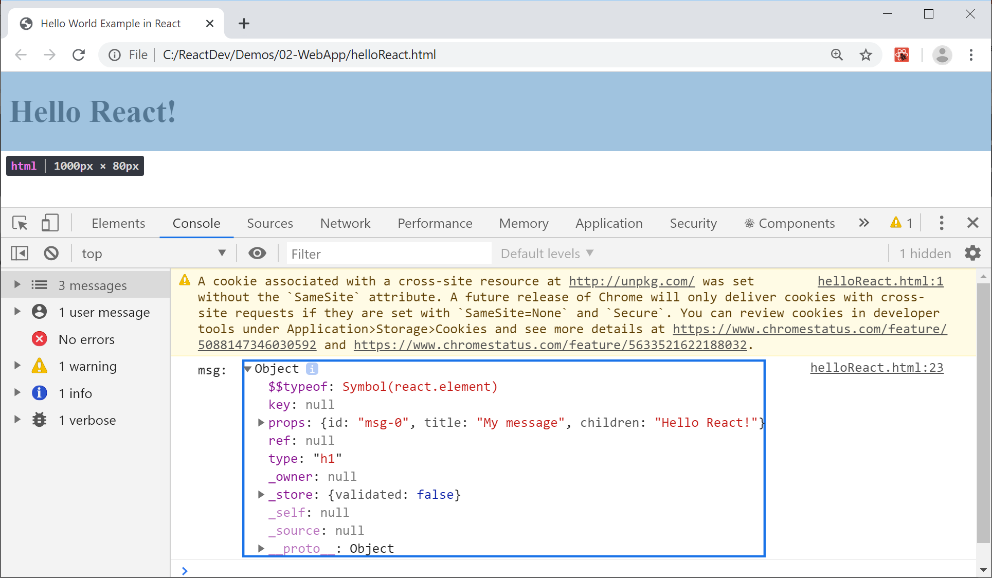
Logging a React Element
A React element is a lightweight object, as shown here
console.log('msg: ', msg)

Slide 11
2. Creating Many Elements
Overview
Hierarchy of React elements
View the page in the browser
View the virtual DOM

Slide 12
Overview
In this section we'll see how to create a more ambitious virtual DOM tree, containing nested React elements
Then we'll render the root React element to the DOM
Actually that's an important point…
You only ever render the root React element to the DOM

Slide 13
Hierarchy of React Elements
createElement() can take a variadic list of child elements, so you can create a hierarchy of elements
For an example, see multipleElements.html
const ul =
React.createElement('ul', null,
React.createElement('li', null, 'Item1'),
React.createElement('li', null, 'Item2'),
React.createElement('li', null, 'Item3'))

Slide 14
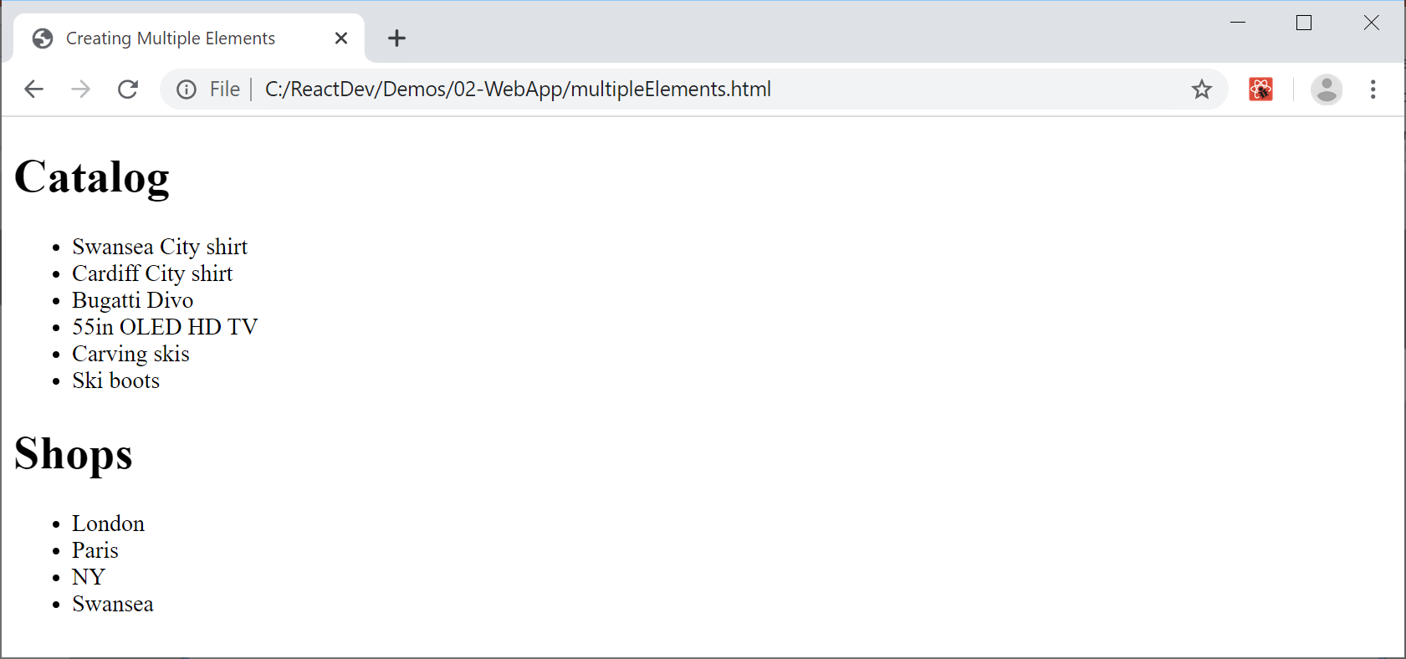
View the Page in the Browser

Slide 15
View the Virtual DOM (1 of 2)
To view components in the virtual DOM, e.g. using React Developer Tools in Chrome:
Show the DevTools window (F12)
Click the Components tab
In the Search window, click the Settings icon
In the popup window, select the Components tab
Deselect the "Hide components where" option
You should now see a list of the components

Slide 16
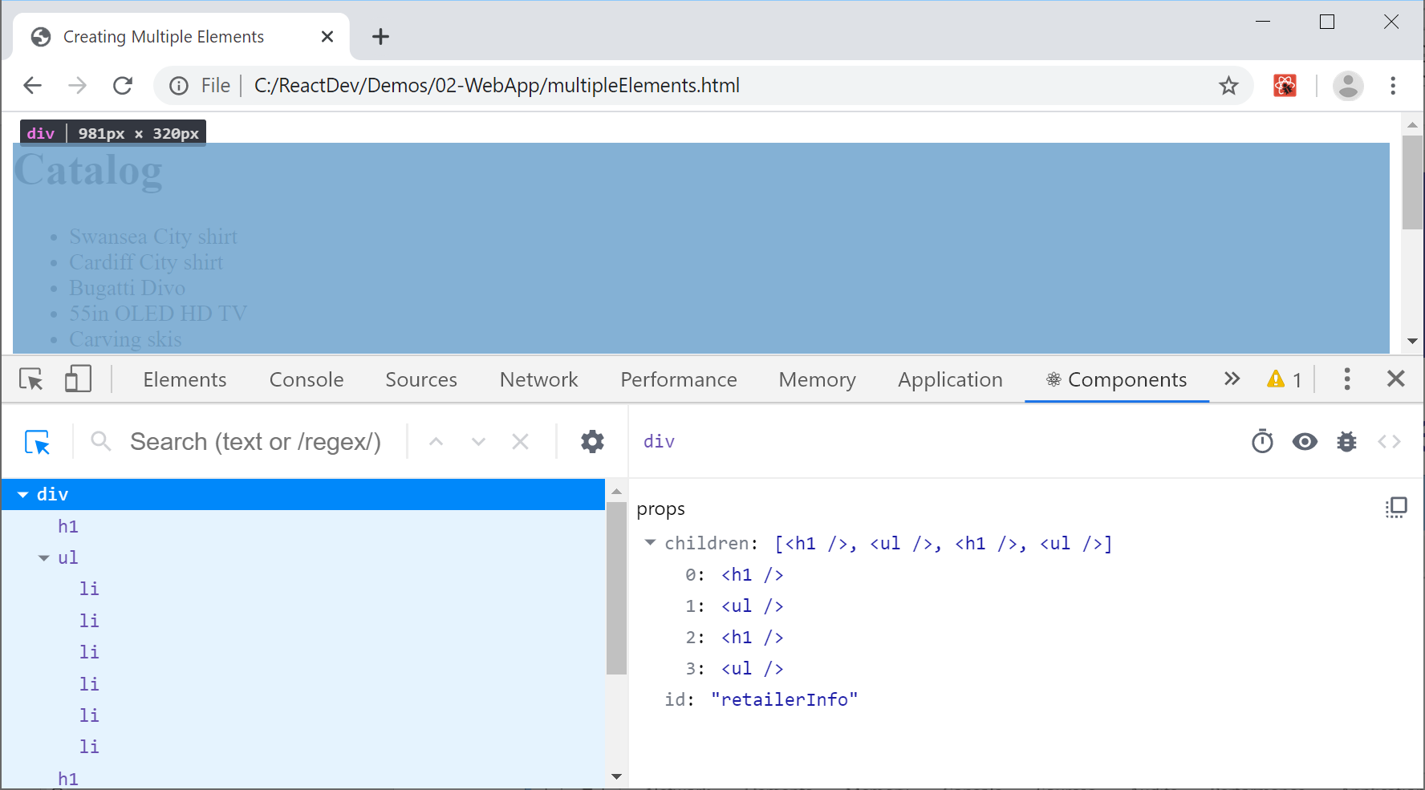
View the Virtual DOM (2 of 2)
Note the children property

Slide 17
3. Data-Driven UIs
Overview
Defining data
Mapping data to elements
Example
View the page in the browser

Slide 18
Overview
The previous section created a hard-coded hierarchy of React elements
In a real app, you'll adopt a data-driven approach
The elements you create will depend on data
We'll see how to create a data-driven UI in this section
See multipleElementsViaData.html

Slide 19
Defining Data
We'll have an array of products and an array of shops
const products = [
'Swansea City shirt',
'Cardiff City shirt',
…
]
const shops = [
'London',
'Paris',
…
]

Slide 20
Mapping Data to Elements
You can use map() to map array item to a React elem
map() takes a function that typically has 2 args
Arg 1 is an array item, arg 2 is the index of the array item
The function creates a React element (with unique key)
someArray.map((arrayItem, index) =>
React.createElement(elem,
{key:index},
arrayItem.someProperty)
)

Slide 21
Example (1 of 2)
Let's map products and shops arrays to <ul>'s
let prodList = React.createElement('ul', null,
products.map((p, i) =>
React.createElement('li', {key: i}, p))
)
let shopList = React.createElement('ul', null,
products.map((s, i) =>
React.createElement('li', {key: i}, s))
)

Slide 22
Example (2 of 2)
Now let's put it all together
let retailer = React.createElement('div', null,
React.createElement('h1', null, 'Catalog'),
prodList,
React.createElement('h1', null, 'Shops'),
shopList
)
ReactDOM.render(
retailer,
document.getElementById('osl-container'))

Slide 23
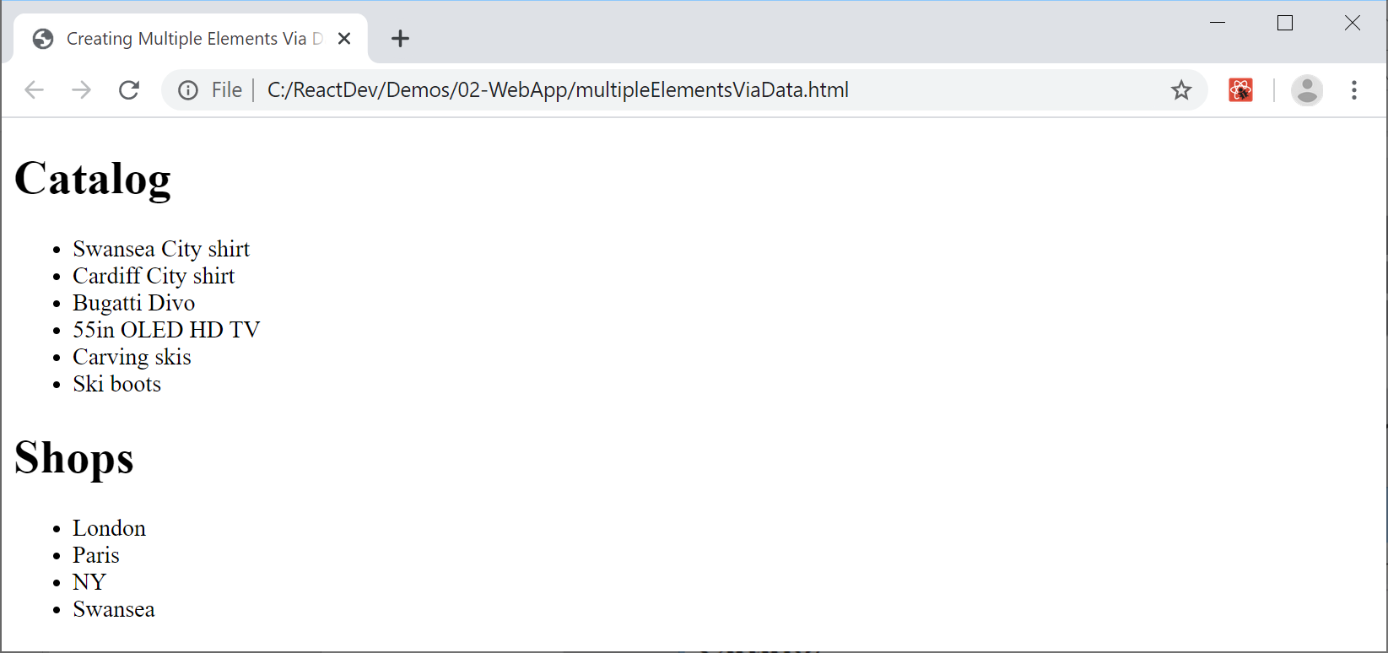
Viewing the Page in the Browser
Here's how the page looks in the browser

Slide 24
Summary
Creating a simple app
Creating many elements
Data-driven UIs

